Slide 1
Milestone 3 STOCK PRICE
PREDICTION
Team 10
Srikanth Parvathala
Vijay Arni
Ya-Ting Yang

Slide 2
Table of contents
01
02
SVM
Neural Networks
03
04
Clustering
Comparative Analysis
05
06
Feature Selection
Ethical Issues

Slide 3
Research Question
Can future stock prices be predictable using historical stock price of specific company and macroeconomic indicators like the nominal GDP index, real GDP index, unemployment rate, and federal funds rate?

Slide 4
SVM
Objective
To forecast the 'Close' price using historical stock data and macroeconomic indicators.
Data collection completed in milestone 1, covering stock prices and indicators like GDP indexes, unemployment rate, and federal funds rate.
Dummy variable encoding, missing value handling, feature scaling.

Slide 5
SVM
Model training:
Linear SVM model established baseline; non-linear SVM models (RBF, Polynomial, Sigmoid) explored complex relationships.
RBF kernel showed best performance, indicating non-linear trends in the data.

Slide 6
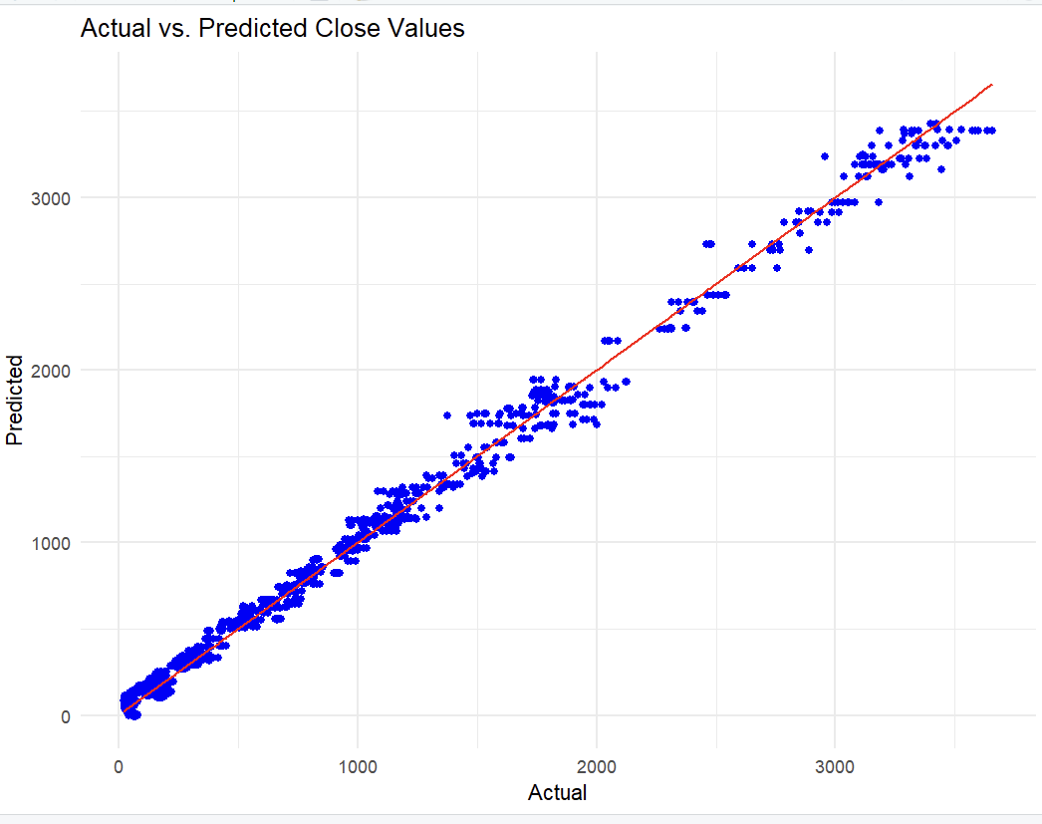
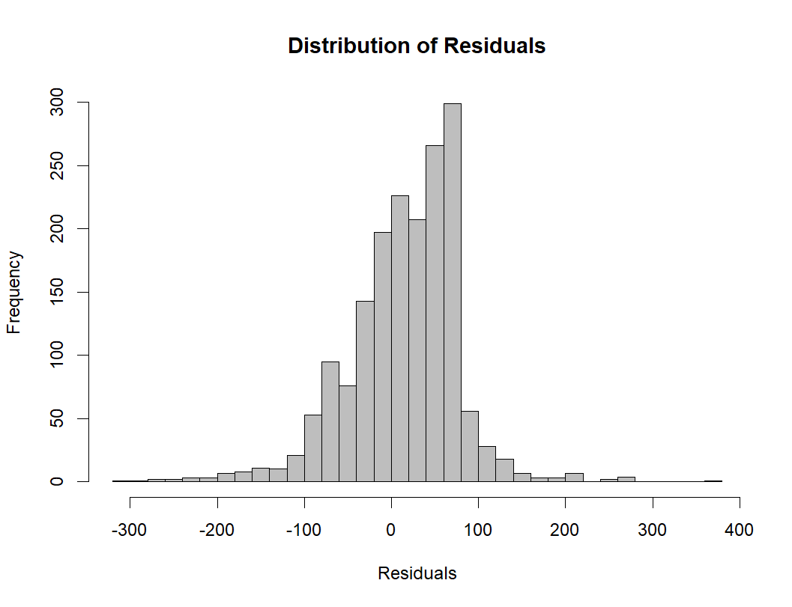
SVM
RMSE Results: Linear (433.97), RBF (66.39), Polynomial (74.26), Sigmoid (50,923.34).
Visualization of Actual vs. Predicted values indicates a strong fit for the RBF kernel model.
Residual histogram suggests areas for model improvement, especially for underprediction.

Slide 7
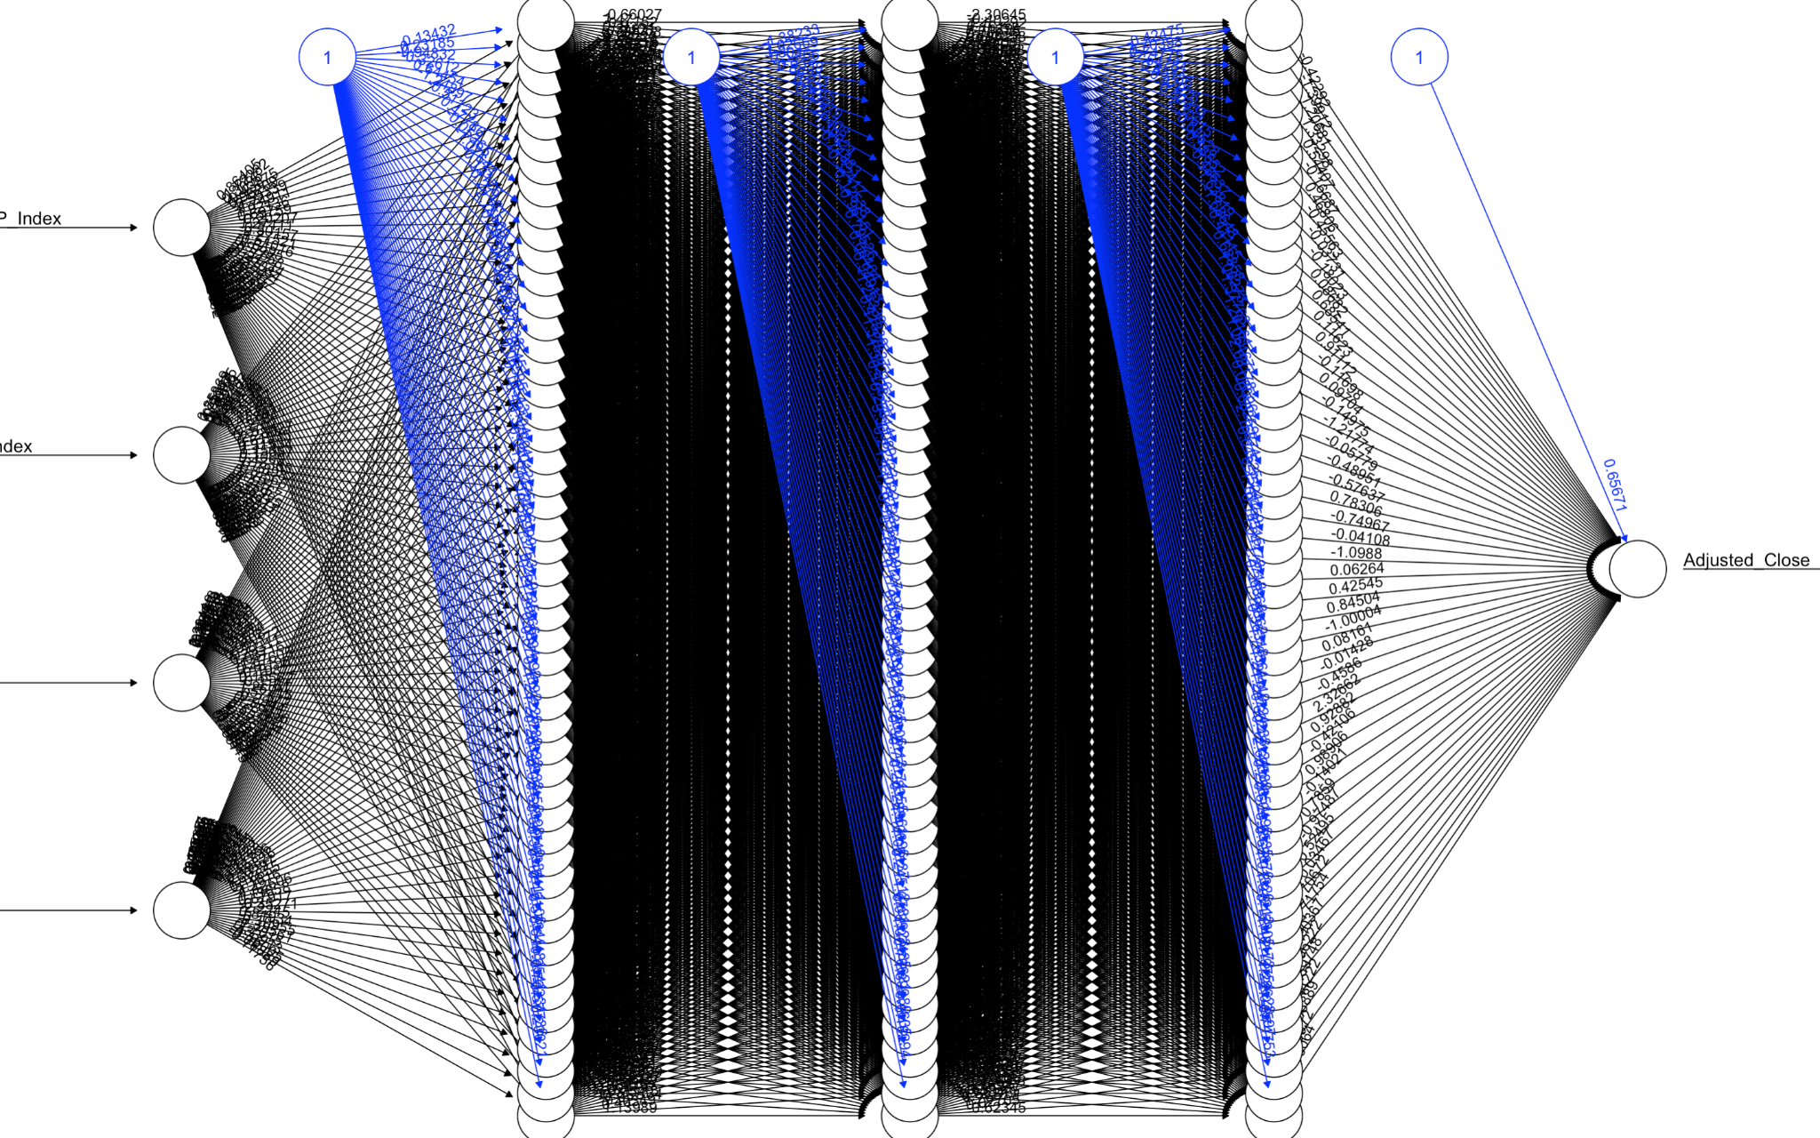
02
Neural Networks
Notes:
In this section, we trained our stock prediction model using a neural network.

Slide 8
Data Preprocessing & Configurations
Normalization of Input Variables
Scaling continuous variables such as GDP indexes, unemployment rate, federal funds rate to a [0, 1] range
Dataset
Stock prices from Amazon, Google, Facebook, Netflix, and Apple
Training Parameters
Setting learning rate at 0.01
Conducting 100 training epochs
Notes:
And Several steps were implemented in our code before initiating the training process.
Firstly, we utilized a normalization function to scale numeric vectors to a [0, 1] range. This step is crucial, as our input variables are all continuous values.
Our dataset include stock prices from Amazon, Google, Facebook, Netflix, and Apple
Later, During the model training phase, we tuned the model using different numbers of hidden layers, neurons per layer, and activation functions. The learning rate was set at 0.01, and the model underwent 100 training epochs.

Slide 9
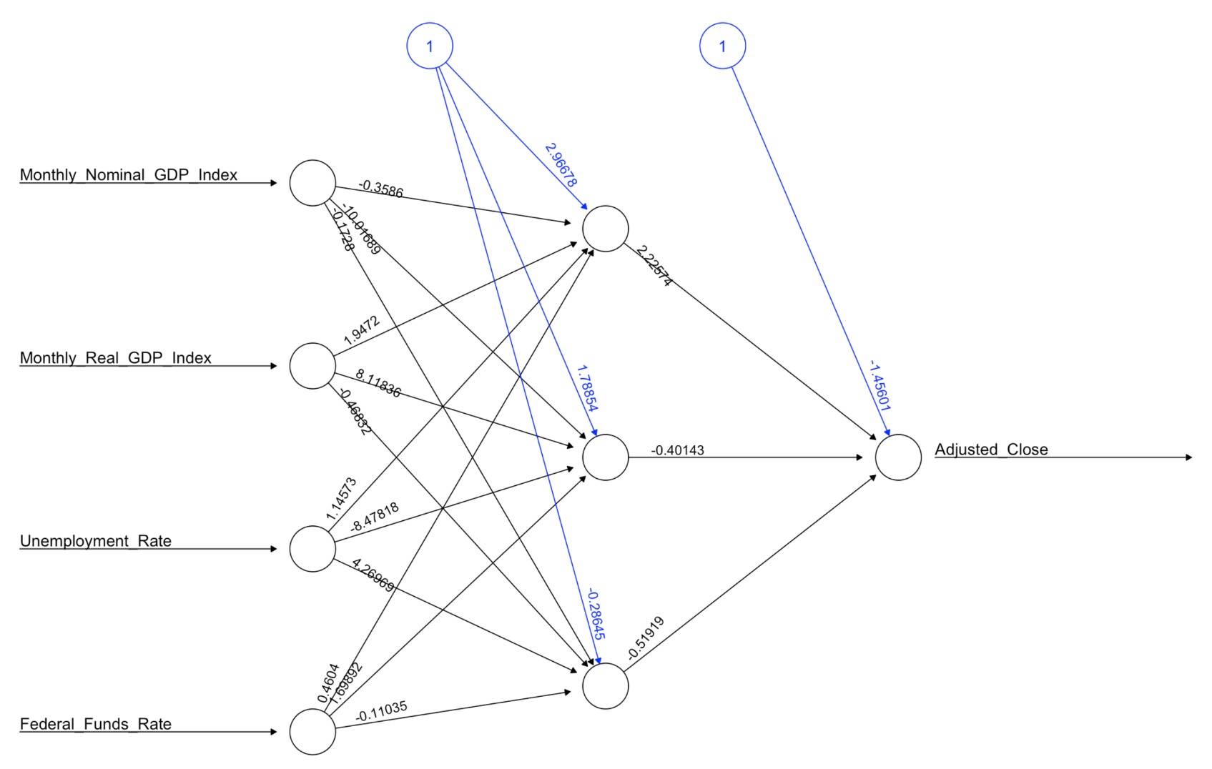
Training Combined Data Model
Hidden layer: 1~4
Neurons: 1~30
Activation function: logistic, tanh
Data: Incorporating stock prices from five major companies
BEST MODEL 1 hidden layer with 3 neurons using the logistic activation function
0.417
Notes:
In our approach to the combined data model, we integrated stock prices from five companies. Our tuning strategy involved experimenting with 1 to 4 hidden layers and exploring neuron configurations ranging from 1 to 30 in each layer. To ensure a comprehensive analysis(噁), we trained each configuration using both logistic and tanh activation functions.
Surprisingly, the most effective result, with a correlation of 0.417, came from a relatively simple model. This top-performing setup consisted of just 1 hidden layer with three neurons, and utilized the tanh activation function. This result highlights the effectiveness of simpler model structures in capturing the complexities of stock price movements across multiple companies.

Slide 10
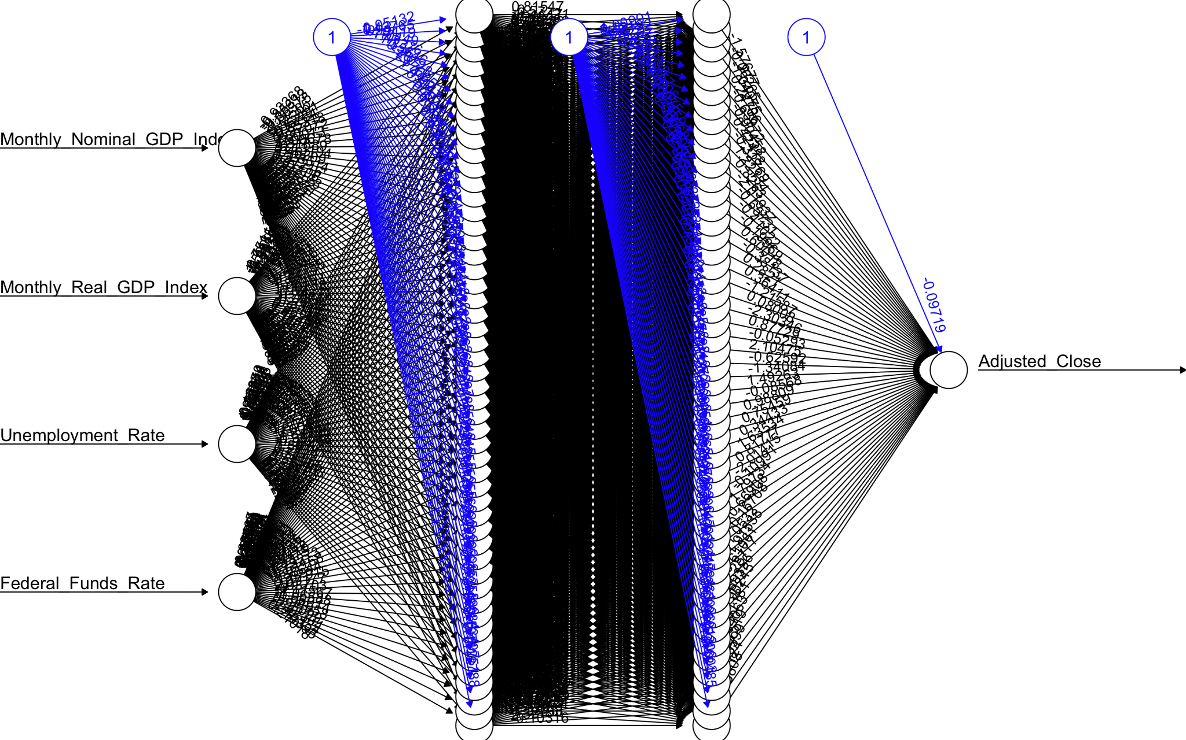
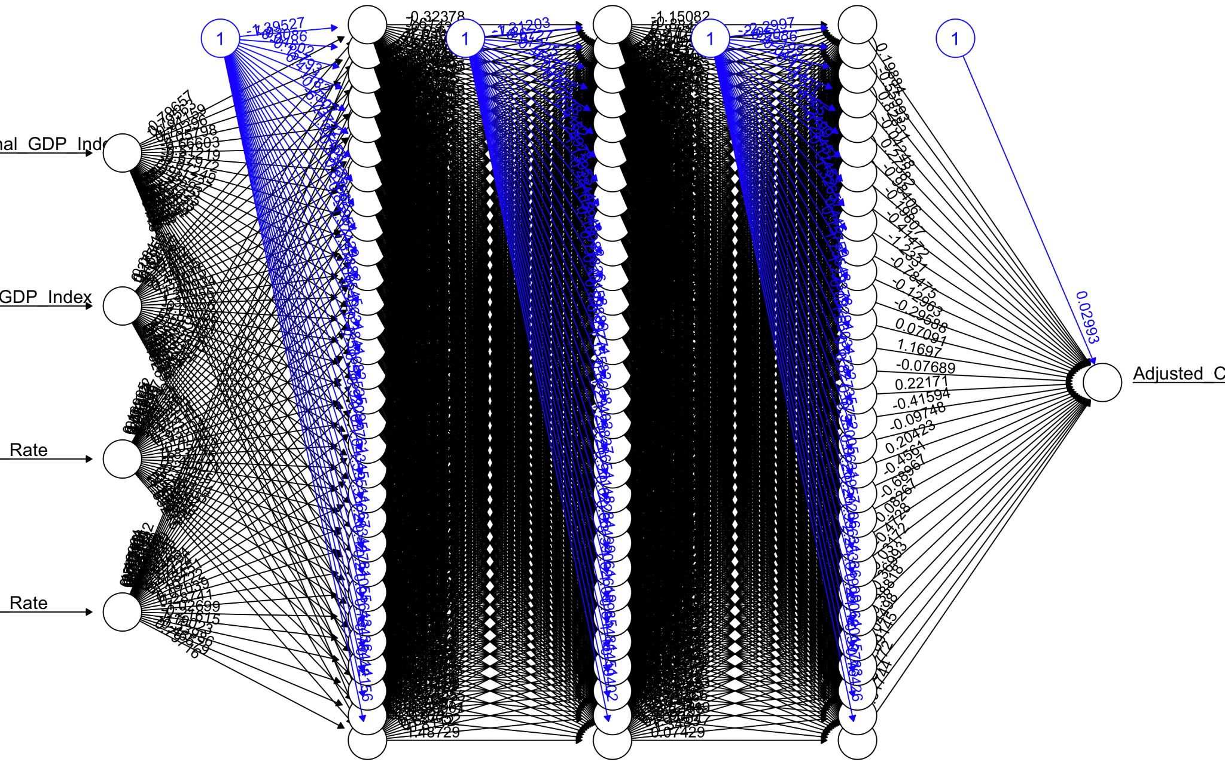
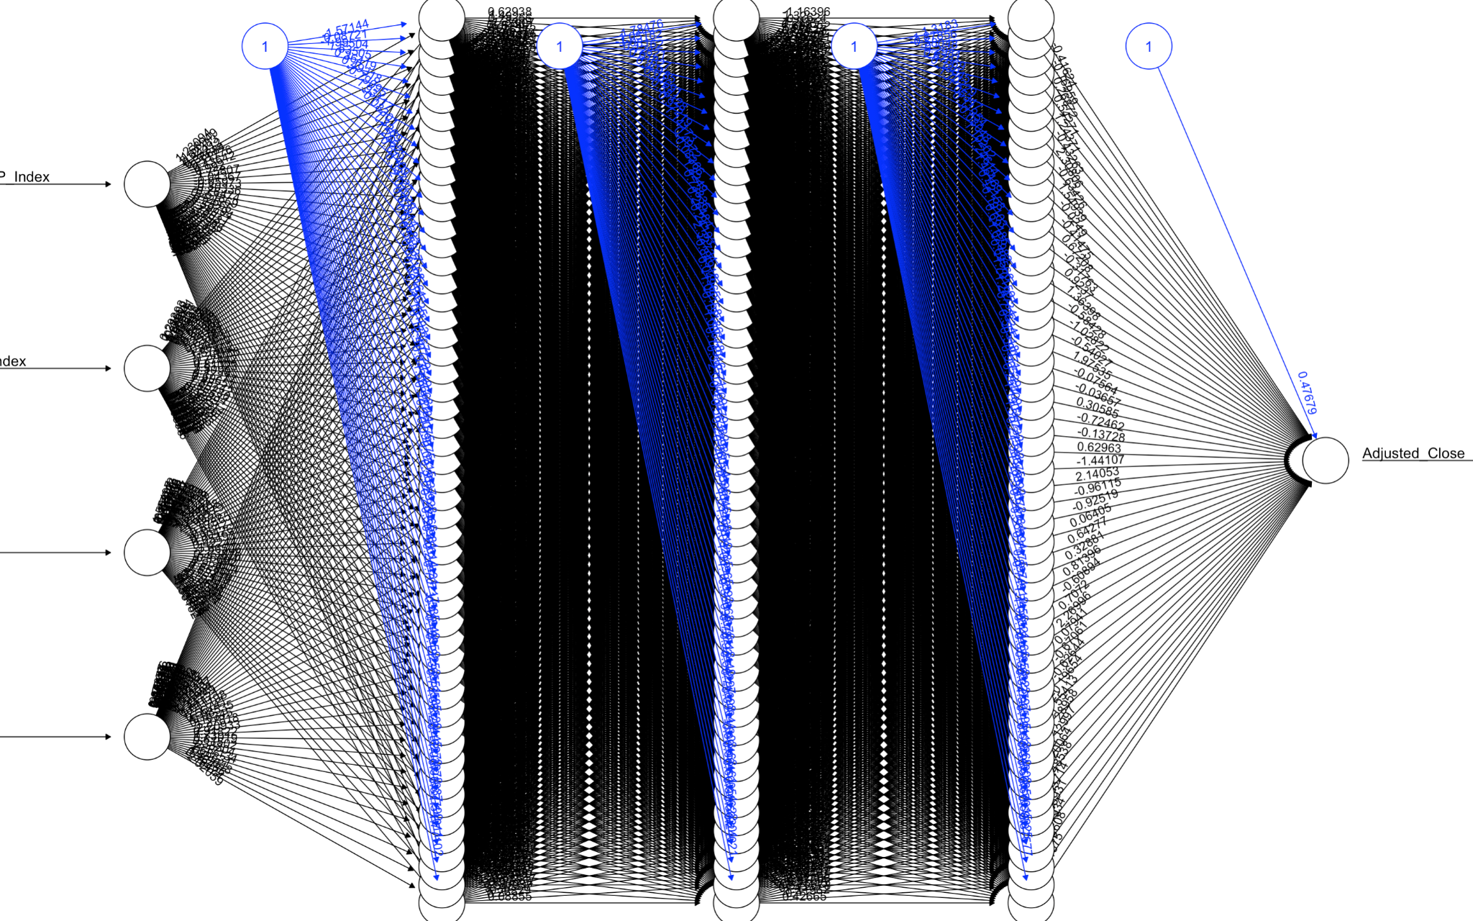
Training Separate Models For Each Company
Hidden layer: 1~3
Neurons: 1~50
Activation function: logistic, tanh
Data: using their specific stock price data
BEST MODEL 2 or 3 hidden layer with 50 neurons using the tanh activation function
0.998
Notes:
In our new approach, we trained separate models for each company using their specific stock price data. This shift allows for a more precise and tailored analysis, as each model is finely tuned to reflect the unique market dynamics and financial trends of the individual company it represents.
Our tuning strategy is similar to that of the previous model. We experiment with different configurations of hidden layers and neurons. The correlation coefficients for these five companies are high across different configurations, ranging from around 0.983 to 0.998.
The best performances from each company were achieved with models trained using a higher number of hidden layers and neurons, such as configurations with 2 or 3 hidden layers and 50 neurons.

Slide 11
Key Findings
Best Performing Models
Combined Data Model
Correlation : 0.417
Simpler models might be sufficient to capture the underlying patterns in the data
Individualized company model
Correlation: 0.998
Better results with more neurons and layers; tanh activation function slightly outperforms logistic.
Notes:
The key finding here is that for the combined data model the overall correlation coefficient was fairly low, at just 0.417. However, what's fascinating is that increasing the model's complexity—by adding more neurons or layers—didn't consistently improve performance. This indicates that simpler models could be enough to capture the essential patterns within the data.
On the other hand, the individualized company model demonstrated an impressive correlation of 0.998. We also observed that models with a greater number of neurons and layers, particularly those utilizing the tanh activation function, had a slight edge over those with logistic activation

Slide 12
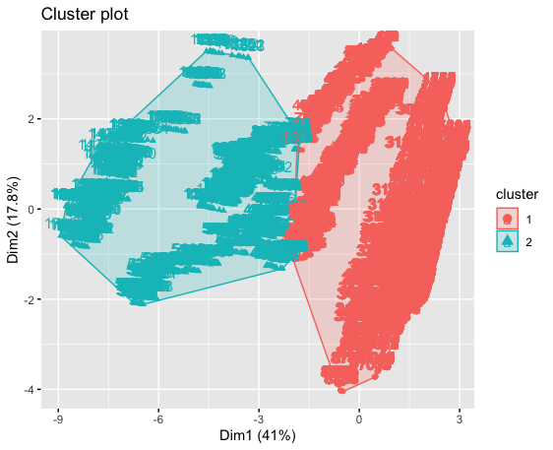
03
Clustering

Slide 13
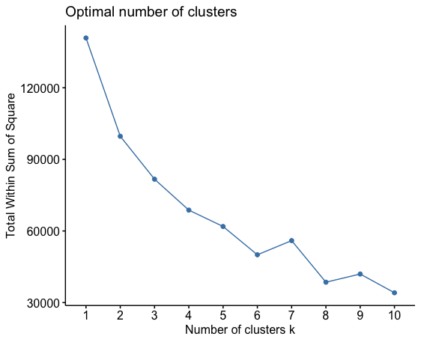
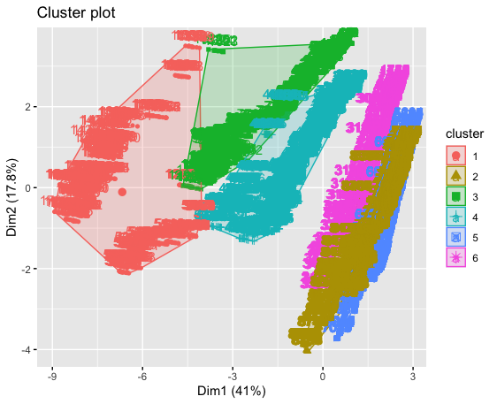
K-Means Clustering
Optimal number of clusters are 6

Slide 14
K-Means Clustering
Number of elements in each cluster are
Cluster 1: 1761
Cluster 2: 1761
Cluster 3: 1532
Cluster 4: 1321
Cluster 5: 669
Cluster 6: 1761
Each centroid of the cluster represents a group of data points (days) with similar characteristics in terms of stock prices, economic indicators, and news sources.

Slide 15
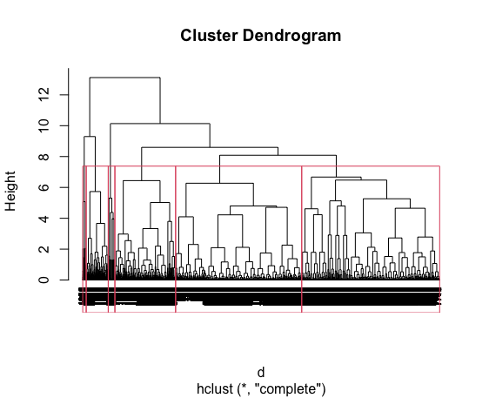
Hierarchical Clustering
Based on Dendrogram, optimal number of clusters are 6.
The number of elements per cluster are :
Cluster 1: 3111
Cluster 2: 1489
Cluster 3: 85
Cluster 4: 544
Cluster 5: 3403
Cluster 6: 164
The largest clusters 1 and 5 , likely represent standard market conditions. In contrast, the smaller clusters capture the more unique and nuanced patterns within the data.

Slide 16
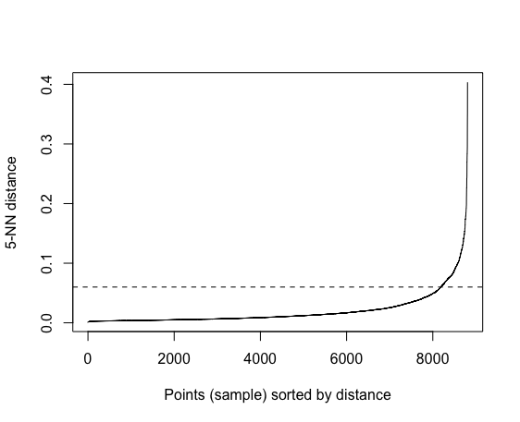
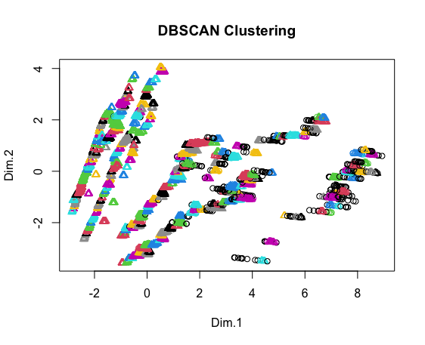
Density-Based Clustering (DBSCAN)
Based on above plot, we found 0.06 is the best epsilon value to train the DB model
Total number of Outliers are 289 points.

Slide 17
Comparative Analysis
Data Set preprocessing:
Features and Size
Normalization and encoding
Conversion of Close into classes
Analytical Methodology:
Machine learning models used: SVM, RF, NN, DT
Cross-validation techniques: K-Fold, Random Subsampling, Bootstrapping
Performance metrics: MSE

Slide 18
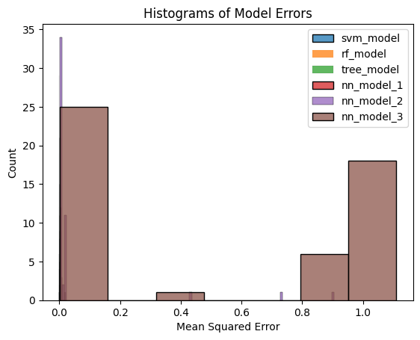
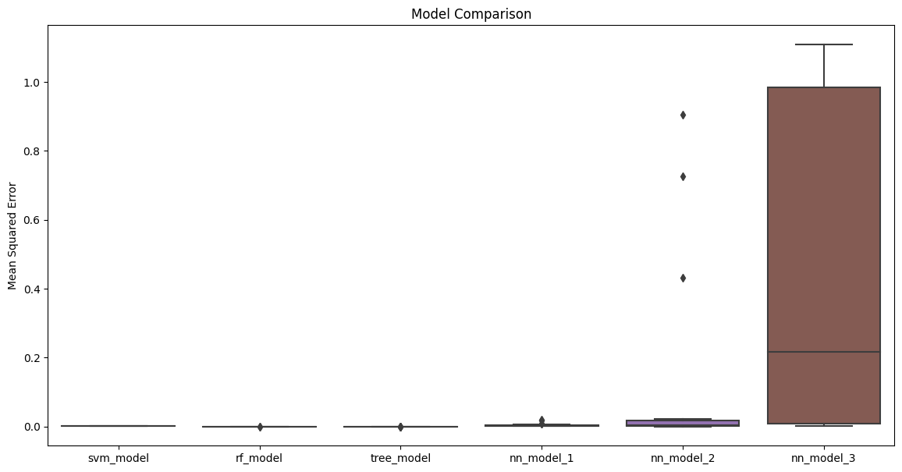
Comparative Analysis

Slide 19
Comparative Analysis
Conclusion:
SVM and RF models are recommended
The potential of NN models with further tuning

Slide 20
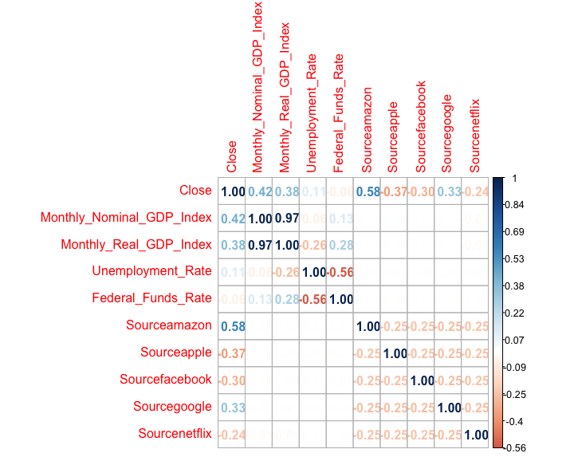
Feature Selection - Filter Method
Filter method on SVM model:
Based on the matrix, "Unemployment_Rate" and "Federal_Funds_Rate"" appear to have the least correlation values with respect to the "Close". So we eliminated both.
Sourceamazon, Monthly_Nominal_GDP_Index, "Monthly_Real_GDP_Index" and "Sourcegoogle" are positively correlated with Close price.
"Sourceapple", "Sourcefacebook", and "Sourcenetflix" are negatively correlated with Close price.
SVM model has low MSE value (0.012) and a high R-Squared value (0.701), demonstrating a strong ability to predict the Close prices.

Slide 21
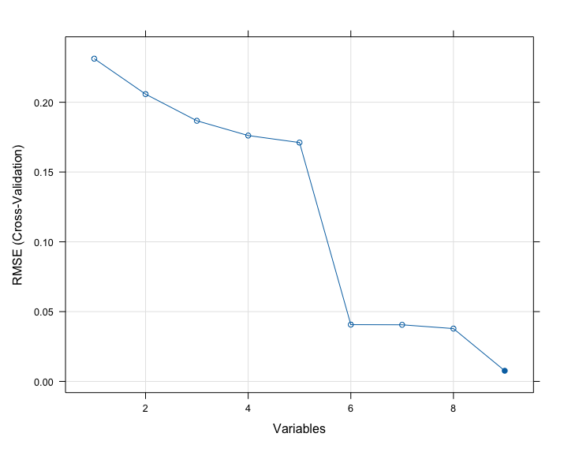
Feature Selection - Hybrid Method (RFE)
RFE on RandomForest model:
From the plot, we can see the number of features increases from 2 to around 5, there's a noticeable decrease in the RMSE.
This suggests that adding more features up to this point improves the model's predictive accuracy.
Selecting more than 5 features does not appear to provide a substantial decrease in RMSE.
Sourcenetflix, Sourcefacebook, Federal_Funds_Rate, Monthly_Nominal_GDP_Index and Sourceamazon are the best features for this RandomForest model.

Slide 22
Feature Selection - Wrapper Method (SFS)
Wrapper method on Linear regression model:
Using a forward stepwise algorithm, a refined model is identified by progressively adding predictors to enhance model accuracy.
The final model included Sourceamazon, Sourcegoogle, Monthly_Nominal_GDP_Index, Unemployment_Rate, Sourceapple, Federal_Funds_Rate, Sourcefacebook, and Monthly_Real_GDP_Index.
Model Performance:
This model demonstrated a high degree of predictive accuracy for stock close prices, as indicated by a high R-squared value(0.7861).

Slide 23
Ethical Issues
Data Collection
Historical stock price data: web scraping and data integrity in financial datasets
Excluding unquantifiable factors such as emotional influence in stock price data
Model Evaluation
Industry bias and its impact on stock market representation
Predictive model influence on investment behavior

Slide 24
References
Alexius, A. (2018). Stock prices and GDP in the long run. https://econpapers.repec.org/article/sptapfiba/v_3a8_3ay_3a2018_3ai_3a4_3af_3a8_5f4_5f7.htm
Farsio, F., & Fazel, S. (2013). The Stock Market/Unemployment relationship in USA, China and Japan. International Journal of Economics and Finance, 5(3). https://doi.org/10.5539/ijef.v5n3p24
Historical Stock Price of (FAANG + 5) companies. (2021, December 30). Kaggle. https://www.kaggle.com/datasets/suddharshan/historical-stock-price-of-10-popular-companies/code?select=Microsoft.csv
Kumbure, M. M., Lohrmann, C., Luukka, P., & Porras, J. (2022). Machine learning techniques and data for stock market forecasting: A literature review. Expert Systems With Applications, 197, 116659. https://doi.org/10.1016/j.eswa.2022.116659
Sharing insights elevates their impact. (n.d.). S&P Global. https://www.spglobal.com/marketintelligence/en/mi/products/us-monthly-gdp-index.html
Shiblee, L. S. (2009). The Impact of Inflation, GDP, Unemployment, and Money Supply On Stock Prices. Social Science Research Network. https://doi.org/10.2139/ssrn.1529254
Unemployment rate. (2023, September 1). https://fred.stlouisfed.org/series/UNRATE

